Slide 1

COVID-19 Immune Response Analysis Using RNA-seq
Jacqueline McCarty
Data 205
Notes:
My Project looks at how immune response and viral load relate to covid-19. using RNA sequencing Data

Slide 2
Data
Datasets
Main: Upper airway gene expression differentiates COVID-19 from other acute respiratory illnesses and reveals suppression of innate immune responses by SARS-CoV-2 (GSE156063)
Complementary dataset: RNA-seq gene expression (GSE152418)
Key variables:
Innate immune score
Viral load (PCR)
Disease Status (COVID vs. Healthy)
Gene expression counts
Source: public GEO dataset (NCBI)
Notes:
I’m using two datasets: one with immune scores and viral load, and a second RNA-seq dataset that lets me analyze gene expression differences between COVID and healthy patients.
What is the new dataset like? What is it about? How does it relate?
Both of the datasets are from GEO - gene expression omnibus
NCBI – National Center for Biotechnology Information

Slide 3
Cleaning
Data Preparation:
Cleaned metadata and gene count matrices
Matched sample IDs across files
Filtered low-expression genes
Created disease status variable (COVID vs. Healthy)
Challenges:
File structures issues (paths and formats)
Aligning metadata with count data
Notes:
The biggest challenge was making sure the gene counts matched the metadata correctly. I also filtered out low-expression genes to improve the analysis quality.

Slide 4
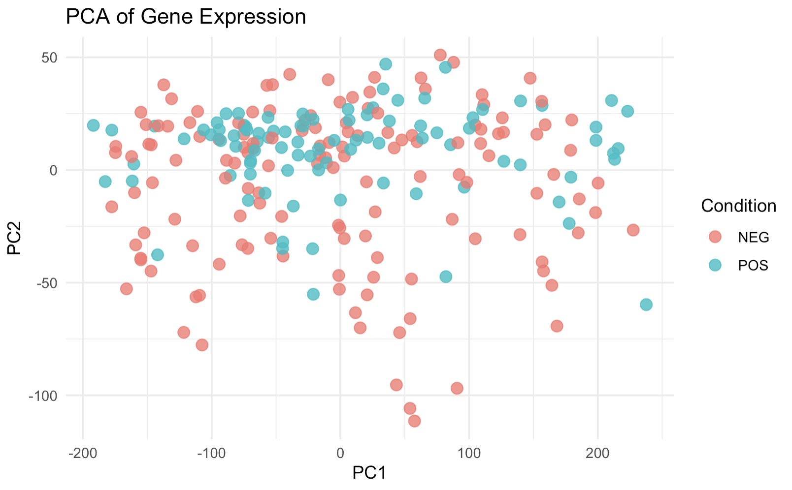
EDA – Principal Component Analysis
Goal: see if COVID and Healthy samples separate
Method:
PCA reduces thousands of genes into 2 components(PC1, PC2)
Observation:
Partial overlap between groups
Some separation suggests biological differences
Interpretation: suggests differences in gene expression patterns, but not completely distinct
Notes:
This PCA plot reduces thousands of genes into two dimensions. We can see that COVID and healthy samples begin to separate, which suggest that there are meaningful biological differences

Slide 5
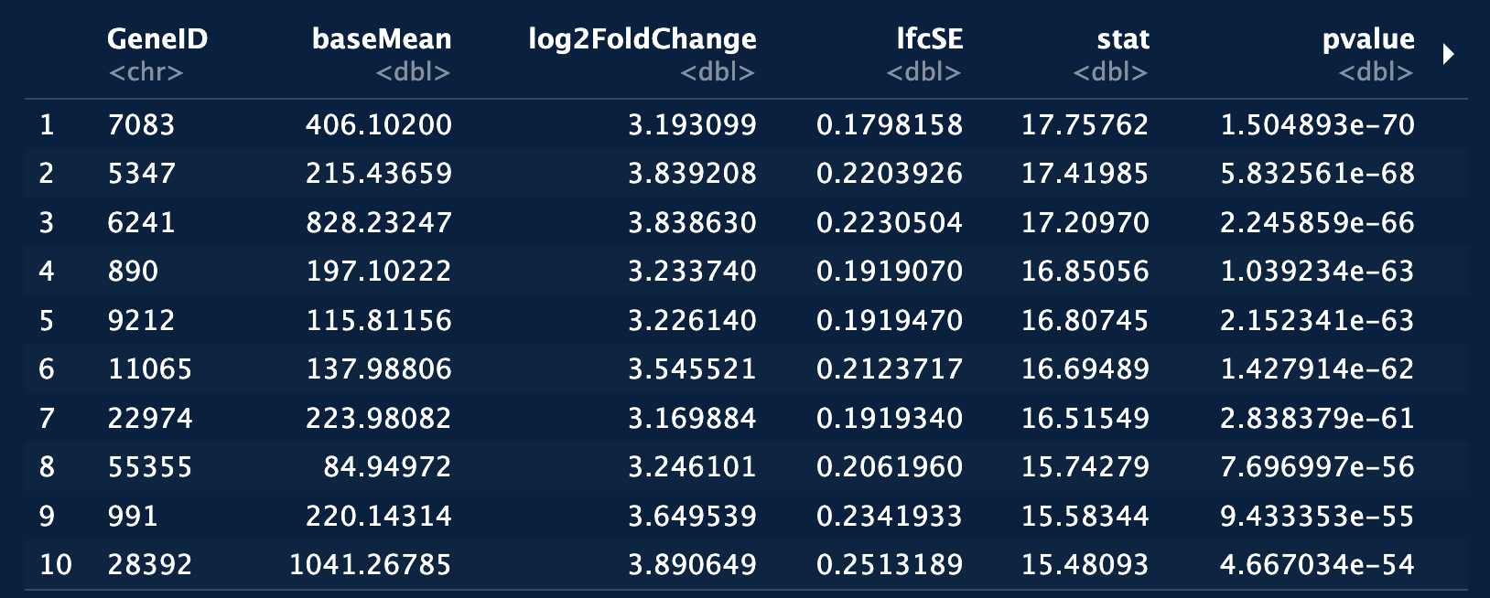
EDA: Gene Differences/Direction
Gene Expression Differences
Using DESeq2:
Identified genes significantly different in COVID patients
Key Insights:
Some genes are strongly upregulated in COVID.
Extremely significant p-values (low)
Example: Top genes show consistent increased expression in COVID
Interpretation: suggests strong immune-related gene activation
Goal: Supports link between immune response and infection.
Notes:
What is DESeq2? It is a statistical method used to find genes that are expressed differently between groups.
Takes your gene count data (RNA-seq)
Compares two groups (COVID vs Healthy)
For each gene, it calculates:
log2 fold change → how much it changes
p-value → how significant the change is
Output = list of important genes
DESeq2, compares gene expression between COVID and healthy samples to find which genes are significantly different.
I used DESeq2 to identify which genes are more active in COVID patients, which helps explain the immune response we saw in the PCA.
These are the top differentially expressed genes. We can see large fold changes and extremely small p-values, indicating strong differences in gene expression between COVID and healthy samples

Slide 6
Next Steps
Finalize differential expression analysis
Create volcano plot visualization
Build classifier (predict COVID status)
Combine immune score + viral load + gene data
Goal:
Better understand immune response to COVID.
Notes:
What is a volcano plot vis? And why should I use it?
Next, I plan to finalize my differential expression analysis and build a classifier to predict COVID status using immune and viral data.

